Slide 1
Sakai 12 / Sakai 13/19 A Perspective

Slide 2
Sakai-12
Sakai-11
Improved look / feel / responsive
Refactoring of Assignments
Lessons enhancements
Test and Quizzes improvements
MathJax improvements
Shopping cart in the text editor
Hibernate 4 upgrade
Elastic Search
Accessibility improvements
Iframe-free
Completely new skin approach
Completely new / responsive skin
New file browser
Completely new gradebook
Move to github
PA System
Test and Quizzes Improvements
New support for MathJax
https://confluence.sakaiproject.org/display/DOC/Sakai+12+Release+Notes

Slide 3
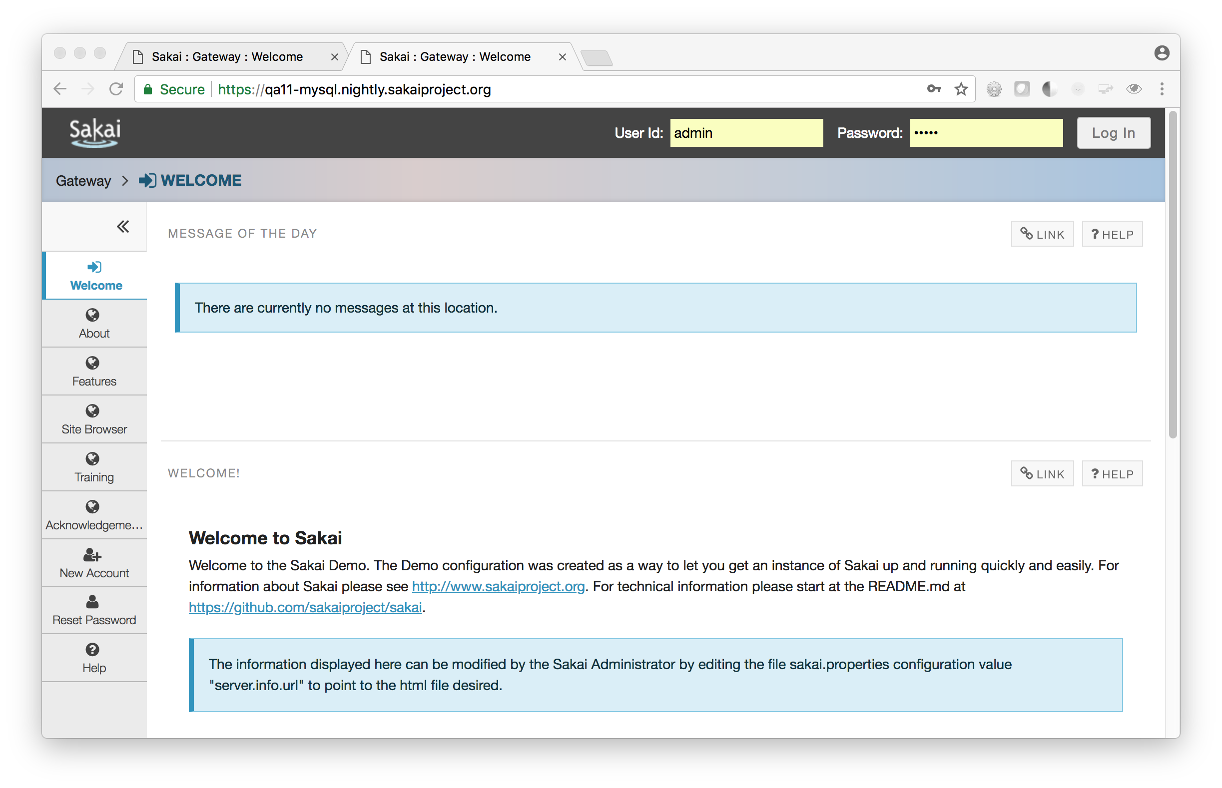

Slide 4
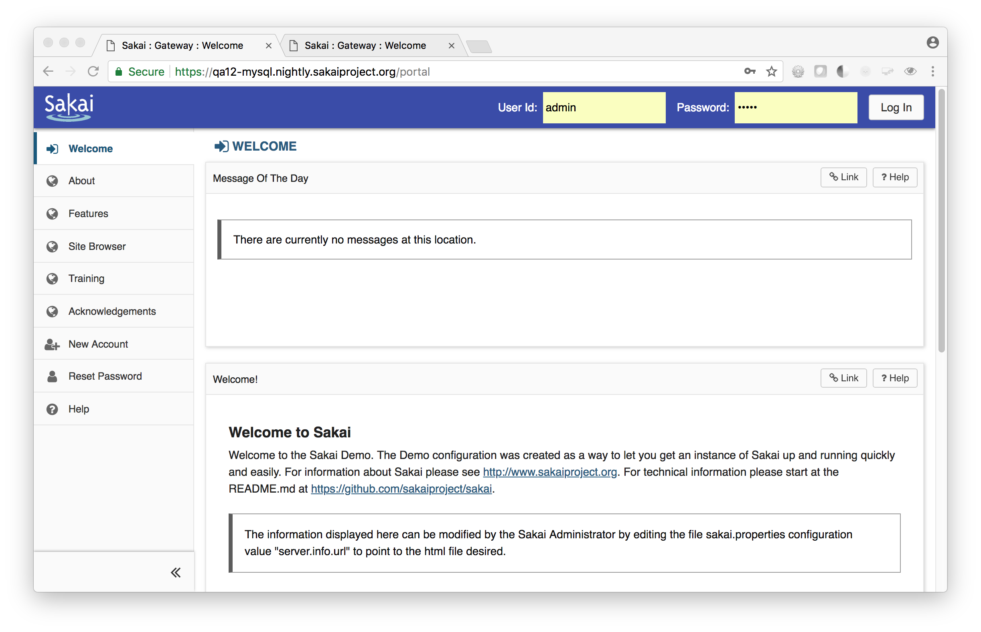

Slide 5
Sakai-13/19
Sakai 12 UI/functionality is pretty solid – Lets not break help docs
I am advocating for two low risk releases in a row
No major initiatives – we look good and function well
App Store – Better LTI Integrations
Better Resource Tool ??
LTI 1.3 groundwork – OAuth 2.0 / APIs with informed consent in mind
Learn about the cloud – distribute best practice
Keep improving accessibility
Bullhorns / Dashboard ….

Slide 6
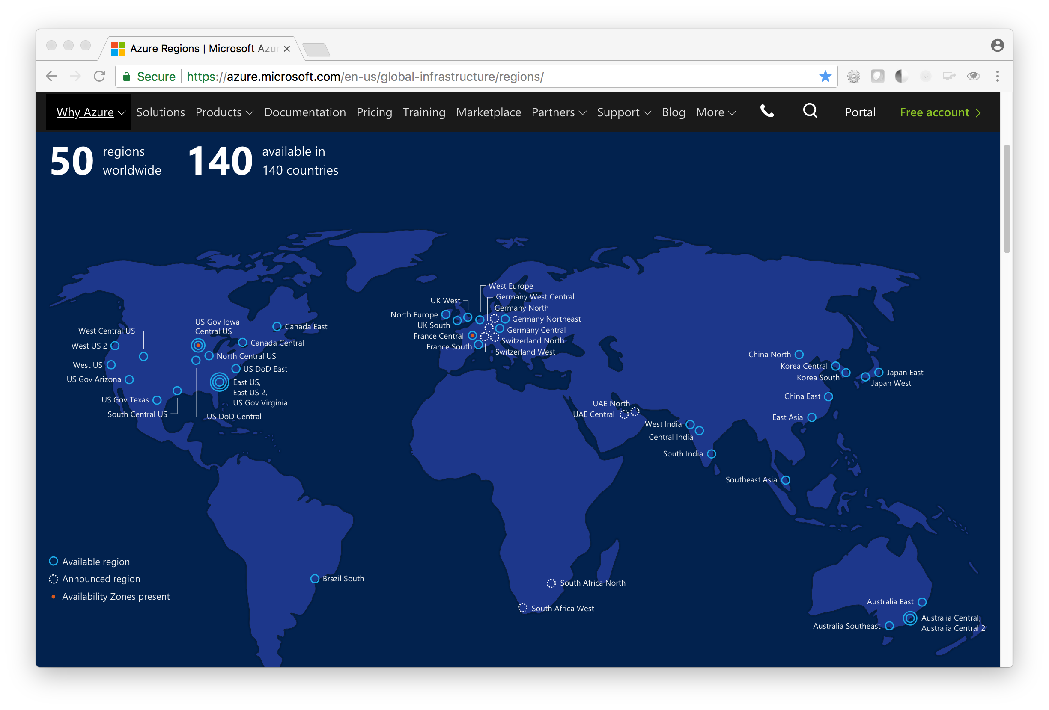

Slide 7
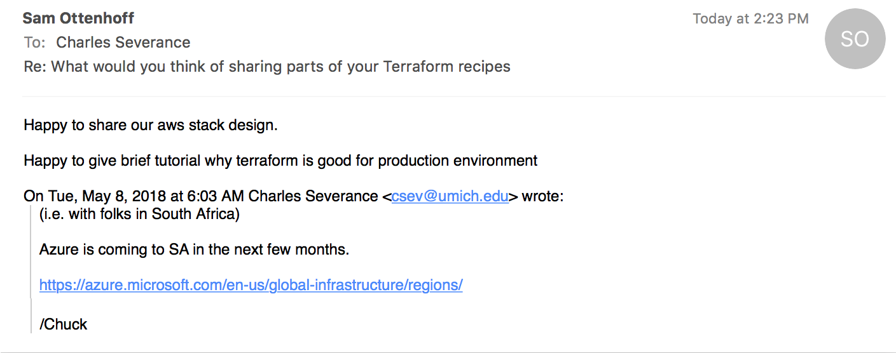

Slide 8


A Scary Market Observation
(Parts of which are true)

Slide 9
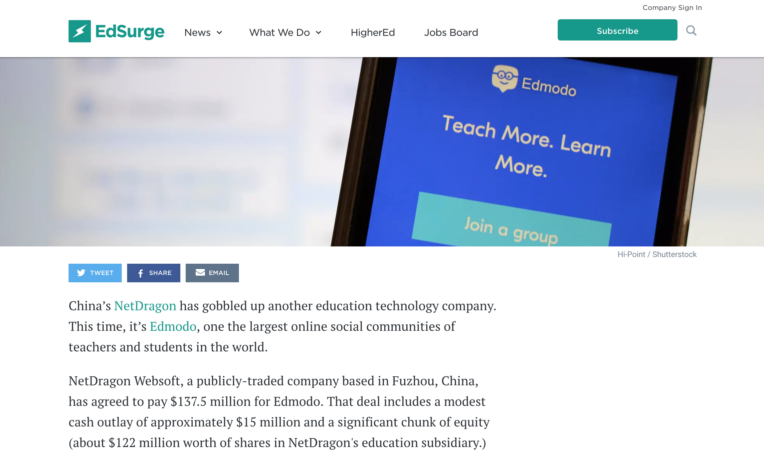

Slide 10
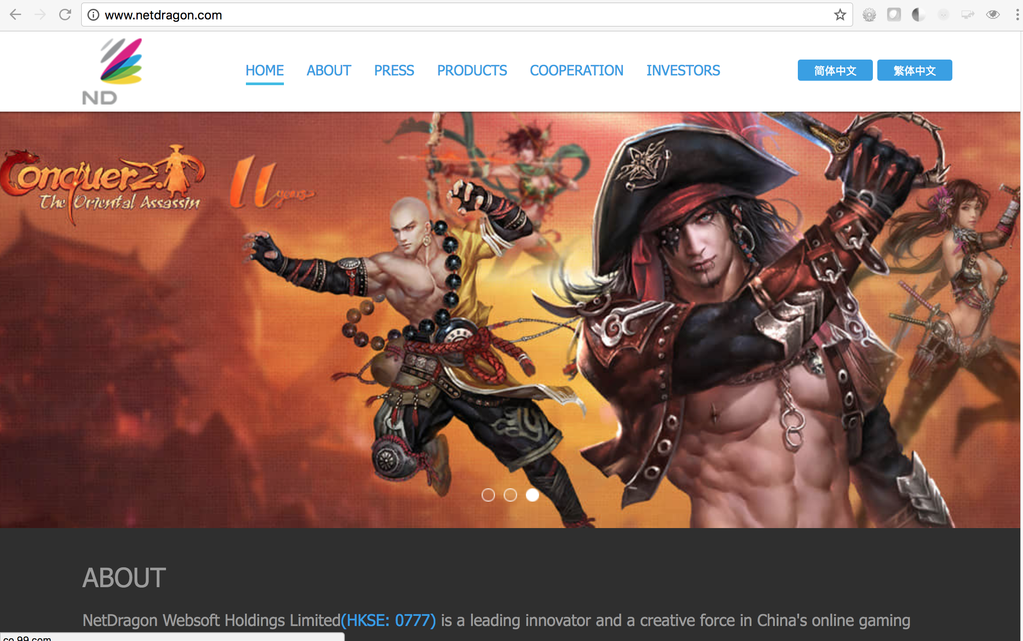

Slide 11



Slide 12


Slide 13
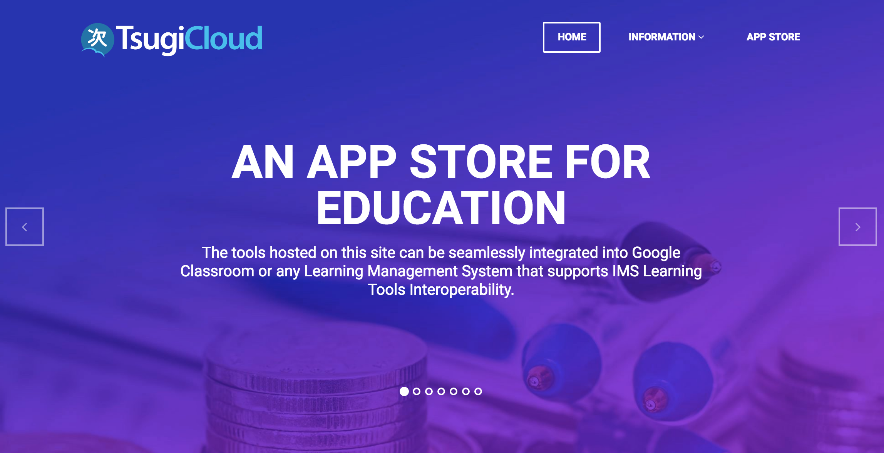

Slide 14
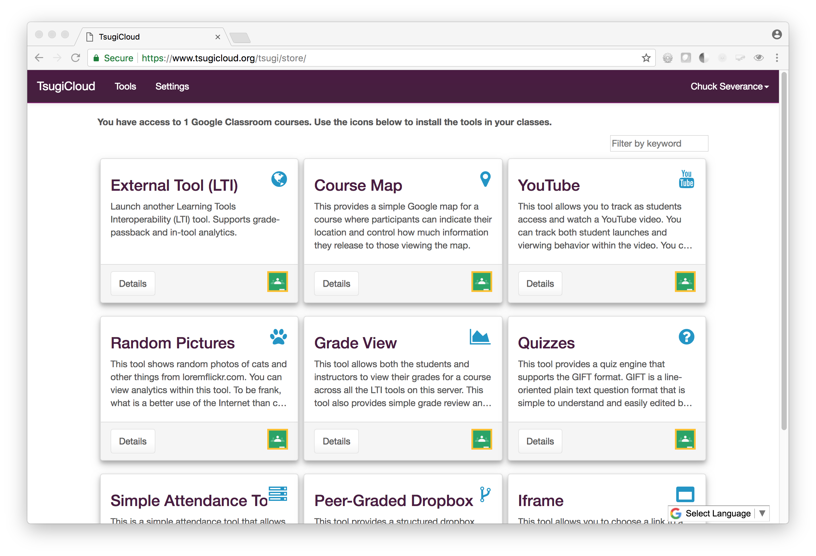

Slide 15

